Slide 1

Chapter 5
by Lale Yurttas, Texas A&M University
Chapter 5

Slide 2
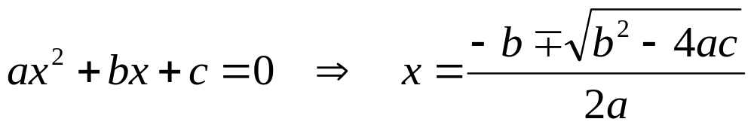
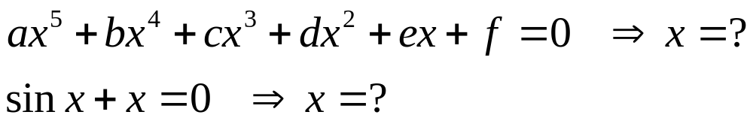
Roots of Equations
Part 2
Why?
But
by Lale Yurttas, Texas A&M University
Part 2

Slide 3
Nonlinear Equation
Solvers
Bracketing
Graphical
Open Methods
Bisection
False Position
(Regula-Falsi)
Newton Raphson
Secant
All Iterative
by Lale Yurttas, Texas A&M University
Part 2

Slide 4
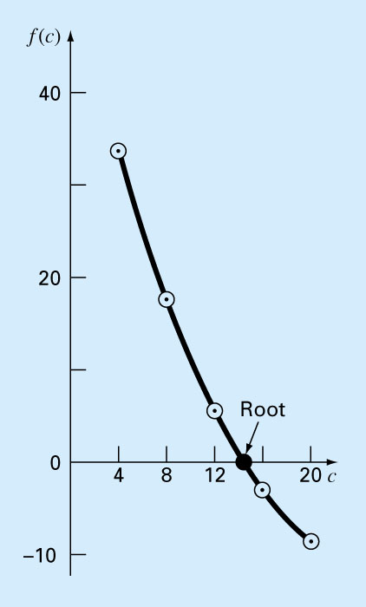
Bracketing Methods
(Or, two point methods for finding roots)
Chapter 5
Two initial guesses for the root are required. These guesses must “bracket” or be on either side of the root.
== > Fig. 5.1
If one root of a real and continuous function, f(x)=0, is bounded by values x=x_{l}, x =x_{u} then
f(x_{l}) . f(x_{u}) <0. (The function changes sign on opposite sides of the root)
by Lale Yurttas, Texas A&M University
Chapter 5
Notes:
Insert Fig. 5.1 in here

Slide 5
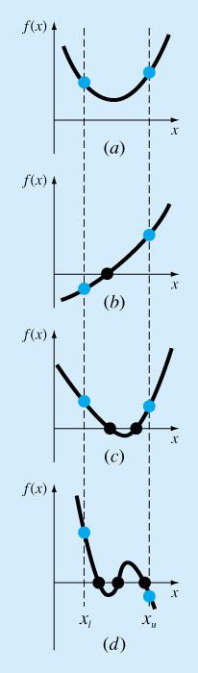
Figure 5.2
No answer (No root)
Nice case (one root)
Oops!! (two roots!!)
Three roots( Might work for a while!!)
by Lale Yurttas, Texas A&M University
Chapter 5

Slide 6
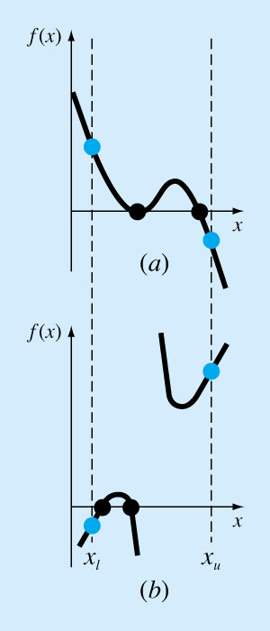
Figure 5.3
Two roots( Might work for a while!!)
Discontinuous function. Need special method
by Lale Yurttas, Texas A&M University
Chapter 5

Slide 7
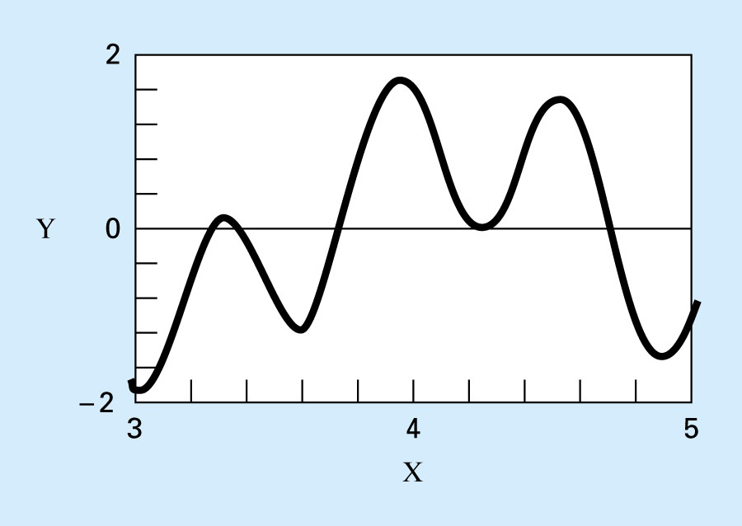
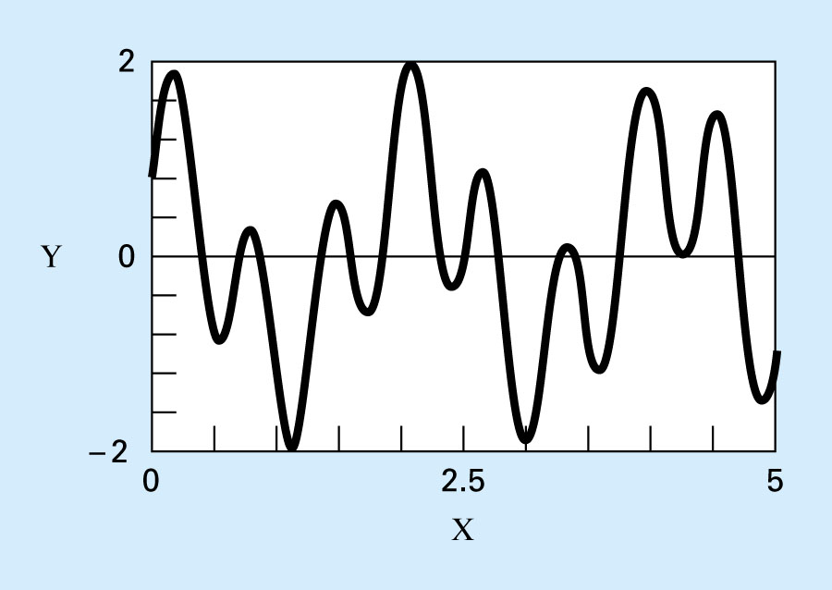
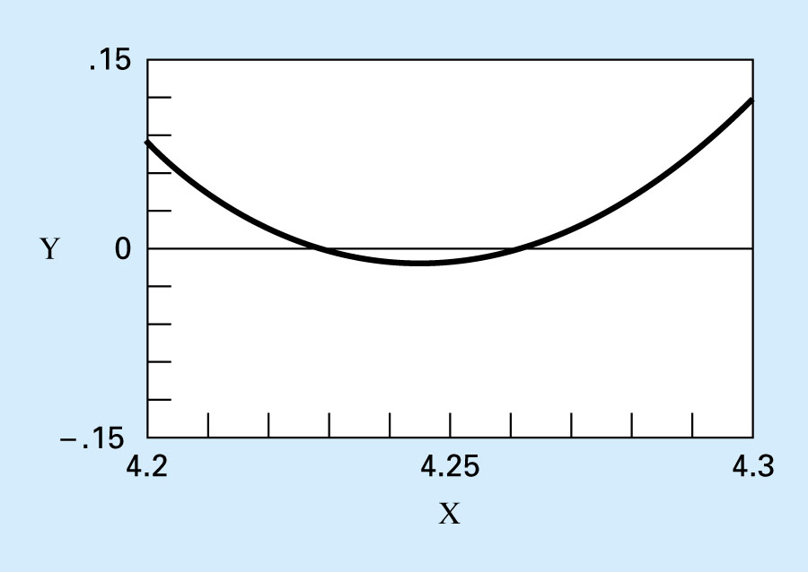
Figure 5.4b
MANY-MANY roots. What do we do?
Figure 5.4a
f(x)=sin 10x+cos 3x
Figure 5.4c
by Lale Yurttas, Texas A&M University
Chapter 5

Slide 8
The Bisection Method
For the arbitrary equation of one variable, f(x)=0
Pick x_{l} and x_{u} such that they bound the root of interest, check if f(x_{l}).f(x_{u}) <0.
Estimate the root by evaluating f[(x_{l}+x_{u})/2].
Find the pair
  If f(x_{l}). f[(x_{l}+x_{u})/2]<0, root lies in the lower interval, then x_{u}=(x_{l}+x_{u})/2 and go to step 2.
by Lale Yurttas, Texas A&M University
Chapter 5

Slide 9
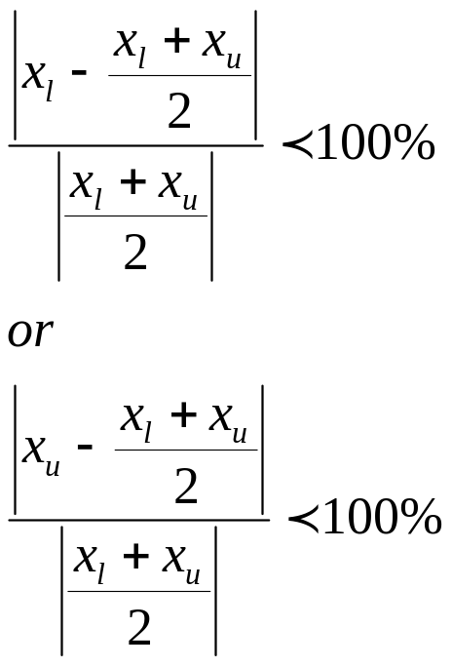
  If f(x_{l}). f[(x_{l}+x_{u})/2]>0, root lies in the upper interval, then x_{l}= [(x_{l}+x_{u})/2, go to step 2.
  If f(x_{l}). f[(x_{l}+x_{u})/2]=0, then root is (x_{l}+x_{u})/2 and terminate.
  Compare ε_{s} with ε_{a}
  If ε_{a}< ε_{s,} stop. Otherwise repeat the process.
by Lale Yurttas, Texas A&M University
Chapter 5

Slide 10
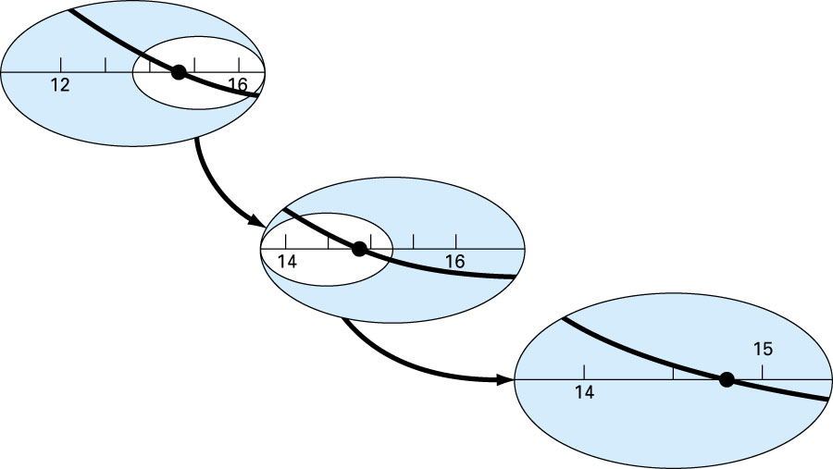
Figure 5.6
by Lale Yurttas, Texas A&M University
Chapter 5

Slide 11
Evaluation of Method
Pros
Easy
Always find root
Number of iterations required to attain an absolute error can be computed a priori.
Cons
Slow
Know a and b that bound root
Multiple roots
No account is taken of f(x_{l}) and f(x_{u}), if f(x_{l}) is closer to zero, it is likely that root is closer to x_{l} .
by Lale Yurttas, Texas A&M University
Chapter 5

Slide 12
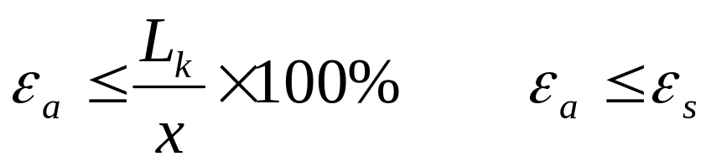
How Many Iterations will It Take?
Length of the first Interval L_{o}=b-a
After 1 iteration L₁=L_{o}/2
After 2 iterations L₂=L_{o}/4
After k iterations L_{k}=L_{o}/2^{k}
by Lale Yurttas, Texas A&M University
Chapter 5

Slide 13
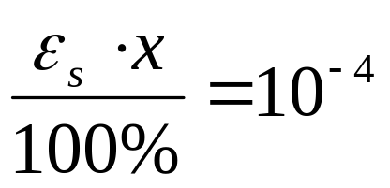
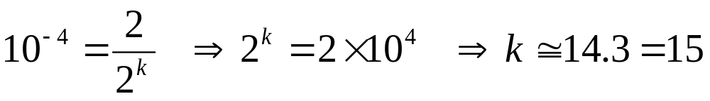
If the absolute magnitude of the error is
and L_{o}=2, how many iterations will you have to do to get the required accuracy in the solution?
by Lale Yurttas, Texas A&M University
Chapter 5

Slide 14
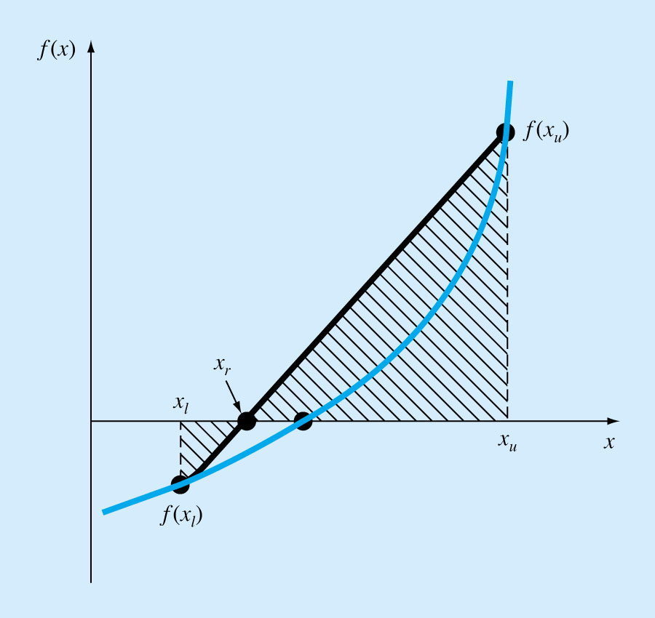
The False-Position Method
(Regula-Falsi)
If a real root is bounded by x_{l} and x_{u} of f(x)=0, then we can approximate the solution by doing a linear interpolation between the points [x_{l}, f(x_{l})] and [x_{u}, f(x_{u})] to find the x_{r} value such that l(x_{r})=0, l(x) is the linear approximation of f(x).
== > Fig. 5.12
by Lale Yurttas, Texas A&M University
Chapter 5

Slide 15
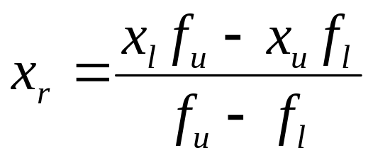
Procedure
Find a pair of values of x, x_{l} and x_{u} such that f_{l}=f(x_{l}) <0 and f_{u}=f(x_{u}) >0.
Estimate the value of the root from the following formula (Refer to Box 5.1)
and evaluate f(x_{r}).
by Lale Yurttas, Texas A&M University
Chapter 5

Slide 16
Use the new point to replace one of the original points, keeping the two points on opposite sides of the x axis.
If f(x_{r})<0 then x_{l}=x_{r} == > f_{l}=f(x_{r})
If f(x_{r})>0 then x_{u}=x_{r} == > f_{u}=f(x_{r})
If f(x_{r})=0 then you have found the root and need go no further!
by Lale Yurttas, Texas A&M University
Chapter 5

Slide 17
See if the new x_{l} and x_{u} are close enough for convergence to be declared. If they are not go back to step 2.
Why this method?
  Faster
  Always converges for a single root.
  ➔See Sec.5.3.1, Pitfalls of the False-Position Method
  Note: Always check by substituting estimated root in the original equation to determine whether f(x_{r}) ≈ 0.
by Lale Yurttas, Texas A&M University
Chapter 5

